Slide 1

The BBC Micro: Bit
Introduction
Enniskillen Royal Grammar School

Slide 2
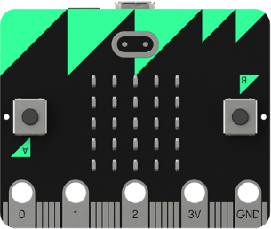
Learning Objectives
Know what a BBC Micro: bit is
Understand the different parts of the device
Use the BBC Micro: bit website to create a simple program

Slide 3
What is the BBC Micro:Bit?
Pocket Sized codable computer
25 red LEDs that can light up, flash messages, create games and invent digital stories
Two programable buttons.
  Can use it as a games controller
  Can even be used to pause or skip songs on a playlist!
Has a motion detector (accelerometer) that can detect movement
Built in compass (magnetometer)
Bluetooth smart technology – can connect to other Microbits or devices

Slide 4
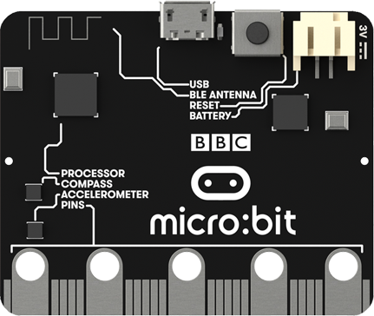
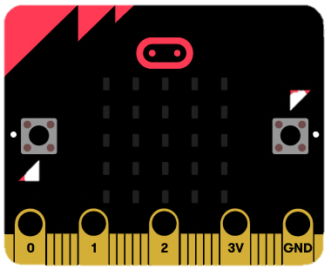
The Components
Programmable Buttons
25 LEDs
Compass
Bluetooth
Accelerometer

Slide 5

How does the LED light array work?
The LEDs are arranged in a 5x5 grid
Much like coordinates, these can be referenced to X and Y.
Unlike coordinates, we reference them like so:
0
1
2
3
4
0
1
This LED would be referenced as (3,1)
2
3
4

Slide 6
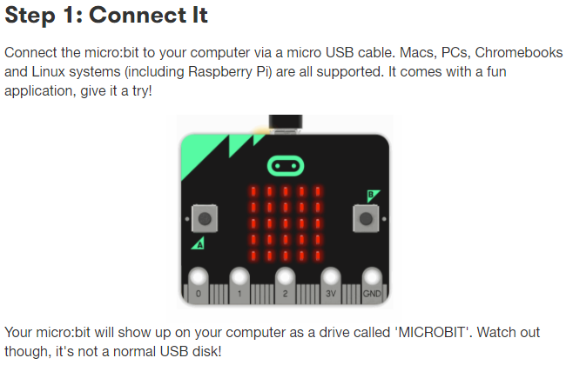

Slide 7
Website
https://makecode.microbit.org/

Slide 8
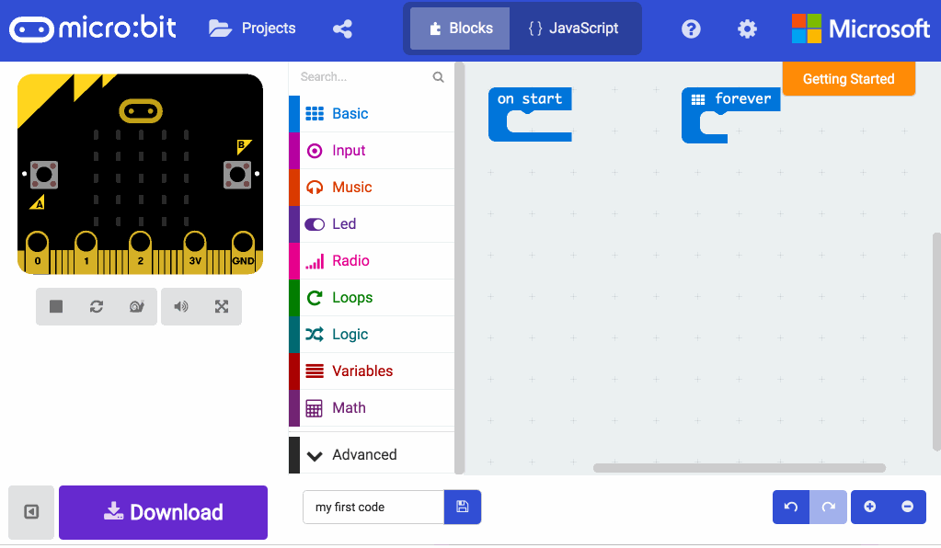

Slide 9
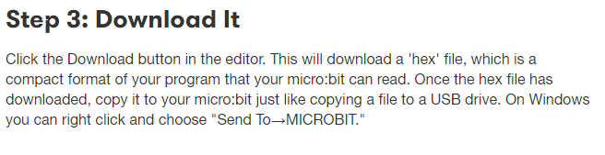

Slide 10
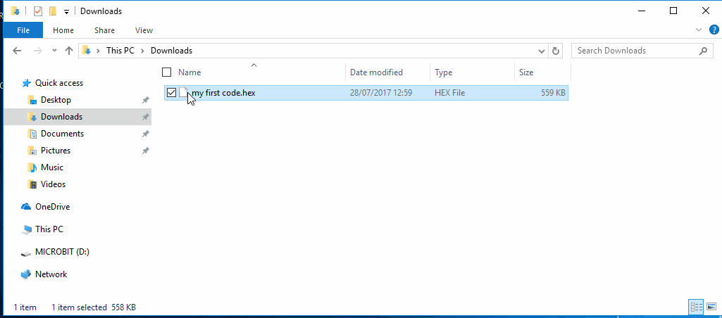

Slide 11
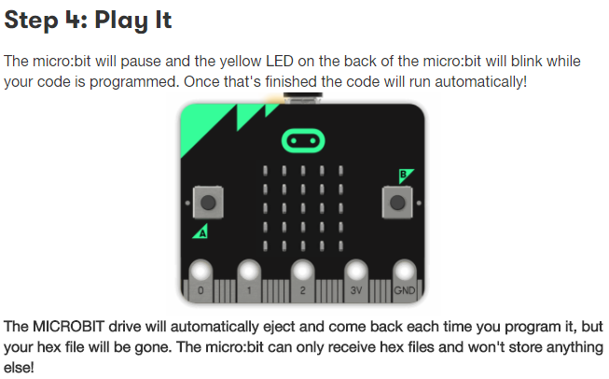

Slide 12
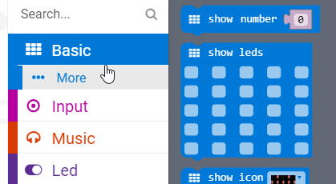
Activity 1: Let’s make an animation!
Open up the Code Editor
Under Basic, use the Show leds

Slide 13
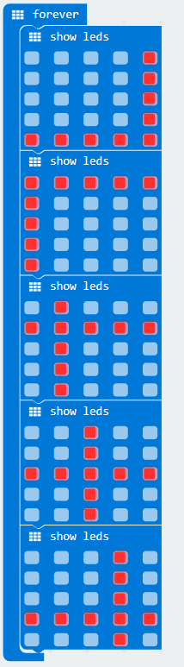
A Simple LED Program
← Create a program similar to this
At the bottom of the screen you can give the program a name. Call this “MyFirstProgram”.
Download and copy your hex file onto the microbit. The LEDs should loop this animation!
Let’s Make another!

Slide 14
What is a ‘string’?
A string is a piece of text.
When we code, we have different types of data that a computer can understand:
  Numbers
    Integer
    Decimal
  Text
    Character
    String
A Whole number (positive or negative)
Numeric value with a decimal point
A single letter/symbol
When we have words/sentences etc

Slide 15

Let’s make a program to say our name!
Open up the website again
Create a loop which uses
Change the string value to “Hello Mr Butler”
Download your code to the BBC Micro bit. Once it has copied across, does your message display on screen?

Slide 16

Programming Buttons
With 2 programable buttons, we can use these as inputs for our Microcontroller.
Let’s make a short program:

Slide 17
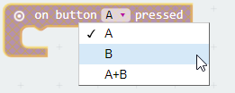
Programming Buttons
We can easily select this to be pressing the B button instead;
Let’s see if you can complete Activity 2 now!

Slide 18

Check Point!
In your My Documents, you should have just Folders for each year.
  Inside these, you should have Subject Folders with no orphan files!
Within your ICT folder, there should now be a HMTL folder (instead of Mr Butler)
  We have created a Micro Bit folder now too
    buttonBashing – Hex File
    MicroBit Portfolio – MS Word Document
    smileyShake – Hex File

Slide 19


Looping
Q: What does the word ‘Loop’ mean in programming?
Ans: To repeat.
For example, we could loop 2 or 3 times. Or 5. Or 100. Or even forever

Slide 20
Save your Hex File into My Documents under Looping.

Slide 21
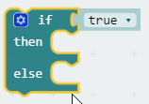

Using the IF function
We have used the IF function in other areas of ICT. Can you name one?
The IF statement uses the blue Logic blocks within the Micro: Bit programming environment.

Slide 22
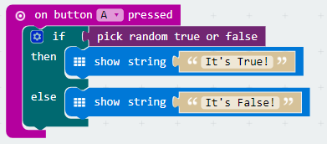
The Lie Detector
Create the script below. Save this as theLieDetector in My Documents

Slide 23
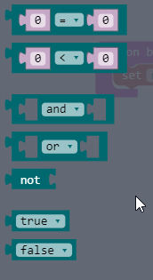
Logic?
There is a lot of logic blocks in the editor.
Some of the blocks are on the right here.
We can think computationally without even knowing about it
  This means we can think like a computer
  When computers run code, we have to tell them exactly what it needs to do as it cannot think for itself. We have to program the intelligence.
  For example, when we make a cup of tea, what steps do we take?

Slide 24

>.< - The Difference
You will notice we have a few different logical operators.
This first one is checking if two values are equal
We also have ‘not equal’
Less Than
Less Than or Equal to
More Than
More Than or Equal to

Slide 25
Logical Operators
We have had some previous experience with logic when we were working on our dice rolling activity.
Logical operators have a true or false outcome.
For example;
IF(5 > 2) ← This is true
IF(3 > 8) ← This is false

Slide 26

Logic Gates
NOT Gate
AND Gate
False
False
True
True
False
False
False
True
True
False
False
False
True
False
True
True
True
OR Gate
NOR Gate
False
False
True
True
True
False
False
True
True
False
True
True
True
False
True
False
False
True
True
True
True
False
False
False

